Slide 1
STEM Starter Academy: Year 6 Evaluation Report
Summary for
Massachusetts Board of Higher Education
Presenter:
Jeremiah Johnson
Team Members:
Ivana Zuliani, Catherine Jett, Donna Spraggon, Jackie Stein, Gaby Stevenson

Slide 2
Today
Year 6 Annual Report
✓ What is STEM Starter Academy?
✓ Who is served?
✓ Key Findings

Slide 3
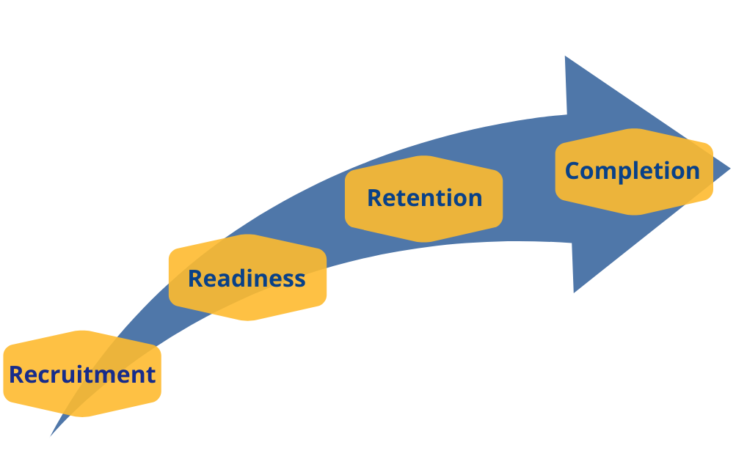
What is SSA? The SSA Model

Slide 4
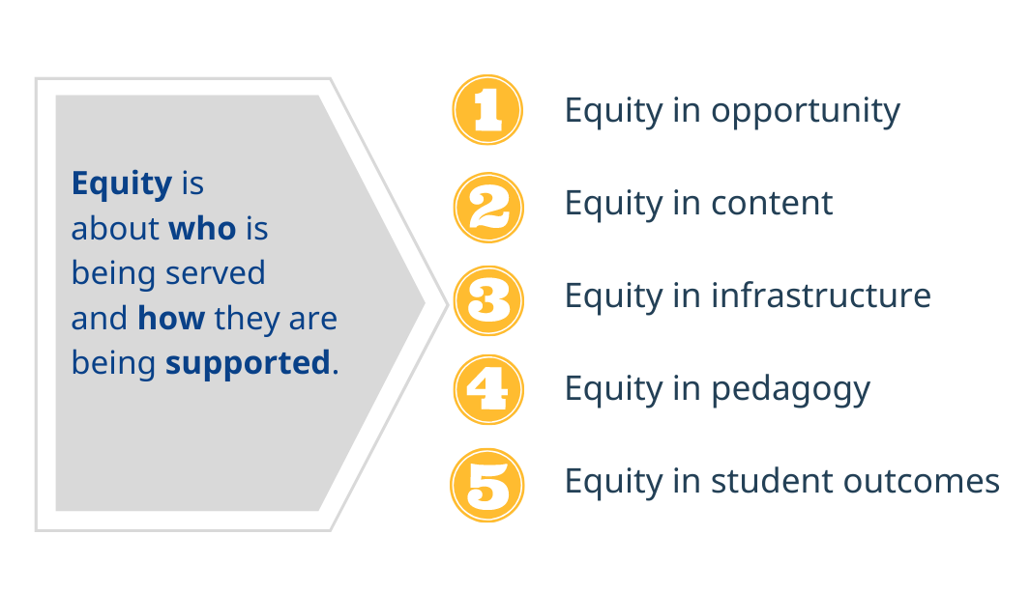
What is SSA? Focus on Equity

Slide 5
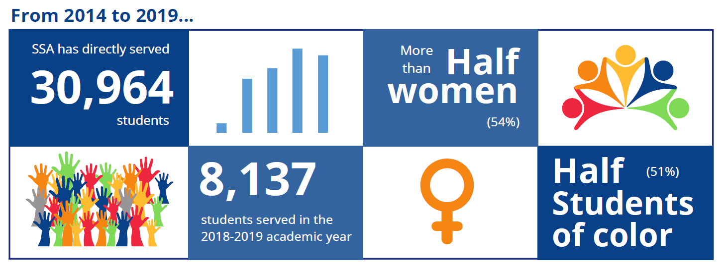
Who is Served by SSA?

Slide 6
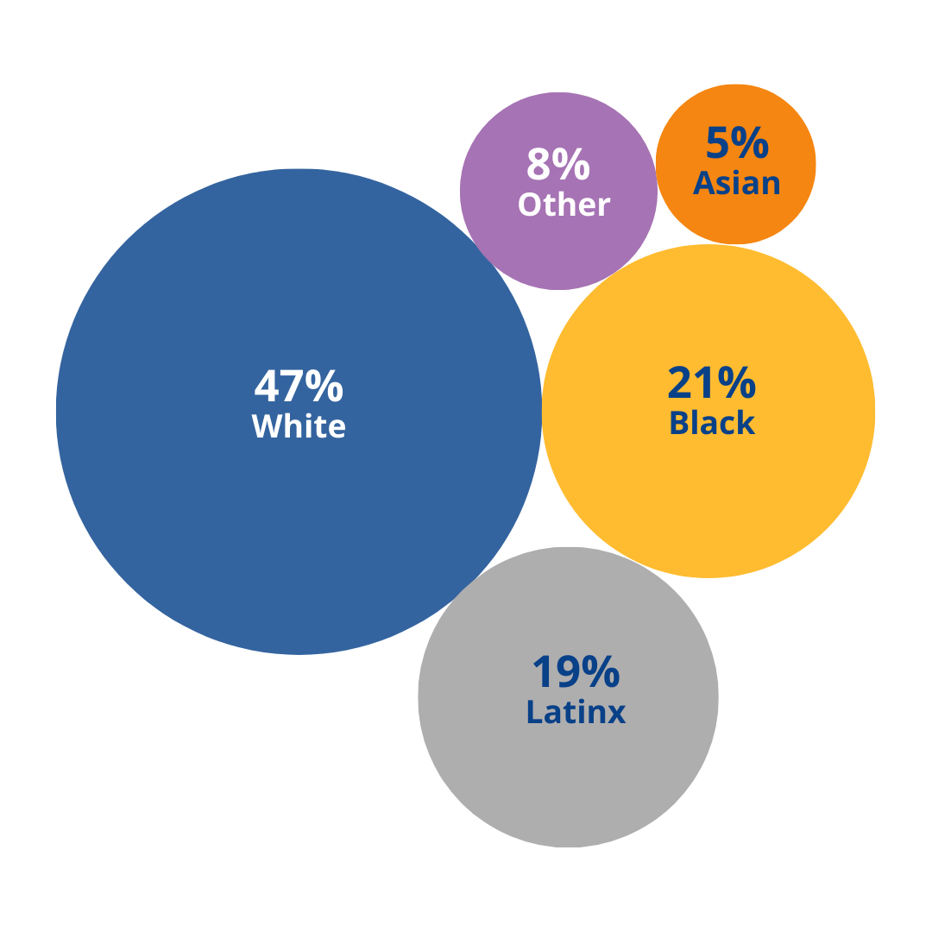
Who is Served by SSA?
SSA promotes increased recruitment and retention of students from diverse backgrounds and who have been traditionally underrepresented in STEM professions.

Slide 7
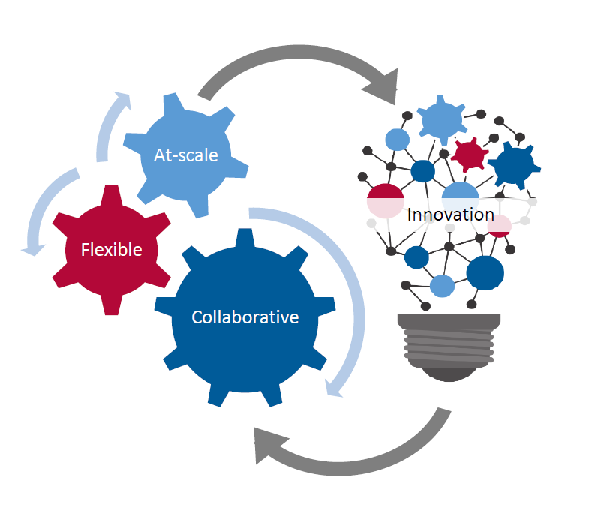
Core Principles

Slide 8
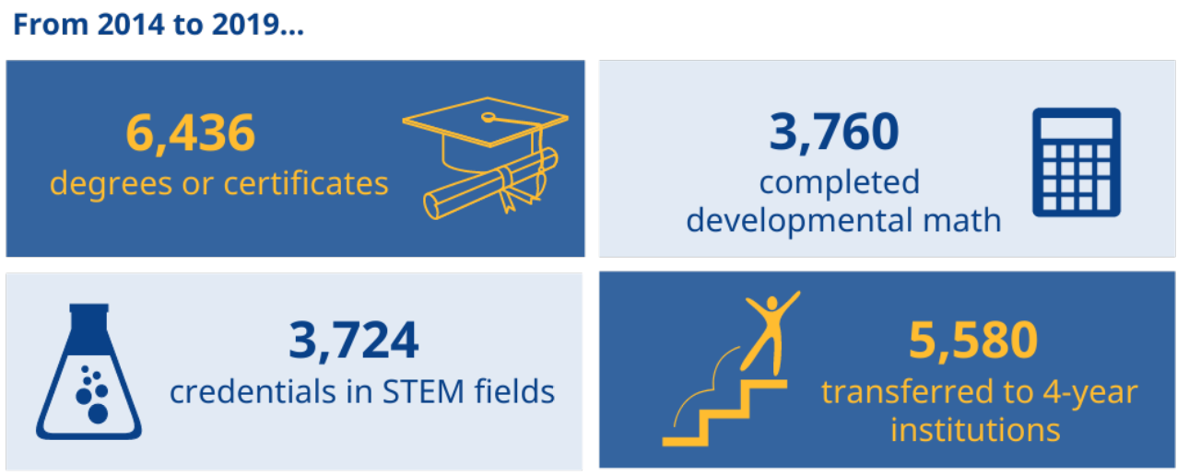
Key Findings: Student Outcomes

Slide 9
Key Findings: Student Outcomes

Slide 10
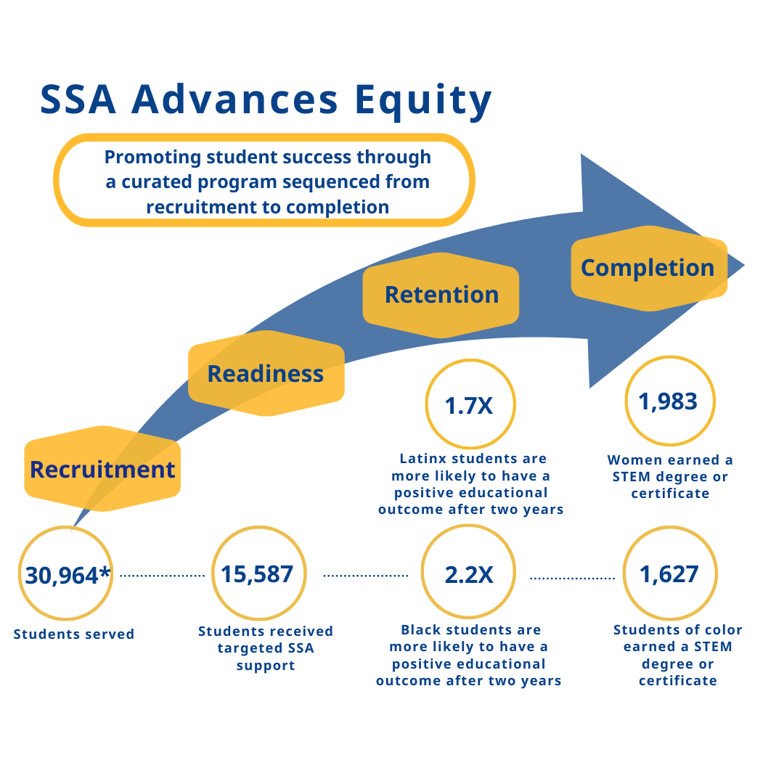
Summary

Slide 11
Thank you!
UMass Donahue Institute
Applied Research & Program Evaluation
100 Venture Way, Suite 5
Hadley, MA 01035
(413) 587-2400
jeremiah@donahue.umass.edu
^{www.donahue.umass.edu}

